Slide 1
Chapter 3: Principles of Software Architecture
Session I: Fundamentals of Software Architecture

Slide 2
Session’s Agenda
Fundamentals of software architecture
  What is software architecture?
  Why is it important?
Key tasks in software architecture
  Stakeholders concerns
  Identify architectural views, styles, and patterns
  Identify major component’s and interfaces
  Evaluating and validating the Architecture
  Introducing policies for design synchronicity
Problem-solving in architecture
What’s next…

Slide 3
Fundamentals of Software Architecture
Let’s get straight to the point, formally, we define software architecture as
  The foundational software design activity that evaluates and translates software requirements (both functional and non-functional) into a collection of design elements that specify structural and behavioral aspects of the major components of the system, together with their provided quality and interrelationships required to support the detailed design and construction of software systems.
  The product resulting from such activity.
From this definition, a few things are of interest and need further explanation:
  Foundational design
  Transforming requirements
  Collection of design elements
  Major system components together with their provided quality
  Support detailed design and construction
Let’s take a more detailed look at these…

Slide 4
Fundamentals of Software Architecture
On “ … foundational software design…”
  Software architecture provides the groundwork essential for meeting requirements
    This applies to both functional and non-functional requirements.
  This suggest that architecture is not an optional activity or activity performed as a means of documenting software systems long after they are implemented.
    New development efforts should approach software architecture as a forward engineering activity that leads to the implementation of systems and not as a reverse engineering mechanism for documentation.
  As foundational design, it is where designing for quality begins. Not considering quality attributes of the system during the software architecture activity can be a grave mistake!
On “…translates software requirements…”
  Requirements is a tricky business! Inexperienced engineers tend not to see the many traps behind the requirements effort.
  Assuming that every requirement is captured and well understood, design elements need to be created so that there is a mapping between requirements and design element.
    One design element (e.g., UML component) can be assigned one or more requirements.
    When we do this, we transform one or more requirements from textual form into a graphical form that represents (in the design domain) the services that need to be provided by the system.
    This allows us to map requirements to design elements and provide the means for tracing requirements through the development life-cycle.

Slide 5
Fundamentals of Software Architecture
More on “…translates software requirements…”
  To create design elements from requirements, it is assumed that requirements are understood. Sometimes this is not the case.
    For example, some may think that “The system shall perform fast.” specifies a requirement that can be used to create design elements.
    Such statements create problems for designers. These problems need to be resolved before we can translate from requirement to design domain.
    This suggest that architects must be proficient in activities related to requirements engineering. We will cover such situations later on in the course.
On “…collection of design elements…”
  This suggest that no one structure or diagram can fully describe the software architecture.
    Think about this: can you evaluate a system’s usability and performance with one diagram?
  This suggest that architectures are composed of multiple structures.
  We will see examples of this later on…

Slide 6
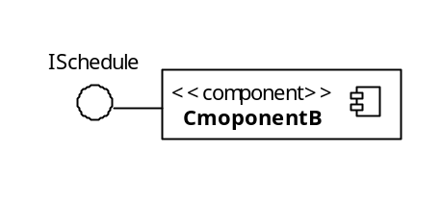


Fundamentals of Software Architecture
  On “…major components of the system, together with their provided quality…”
    This suggest that software architecture works at a distinct level of abstraction that differs from other forms of design, such as detailed design.
    This means that architectural work focuses on the major components, the quality properties, and services that these components exhibit and provide to other components.
This is an important statement about Software Architecture
Example A
Example B
IOptimizer
The architectural effort requires designers to focus not only on decomposition, but also on the quality provided by identified components!
IOptimizer
I provide an Algorithm
I provide an Algorithm
This is equivalent to tagging a component with important information, so that its quality is known by clients using services from the component.
I guess this
component
will do …
Component Quality:
Performance: O(n³)
O(n³)!
Yikes!
Reusability: Low
…
Client needing a fast algorithm

Slide 7
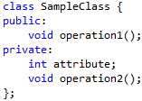
Fundamentals of Software Architecture
  More on “…major components of the system, together with their provided quality…”
    Expected quality requirements identified during architecture trickles down all the way to the implementation of components.
      This provides developers with enough information to produce code that meets the system’s functional and non-functional requirements.
Code
PROCESSING
Detailed
Design
Code
…
IN
OUT
Code meets quality requirements, per the specification
Quality requirements assigned to component
Important:
We are focusing here on quality requirements, but the same applies to functional requirements
Programmer

Slide 8
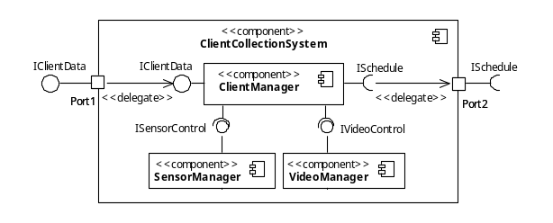
Fundamentals of Software Architecture
  On “…support detailed design and construction…”
    Although architecture focuses on the quality properties of the system, it must also result in a design that supports efficient detailed design and construction of the system.
      Even though Architects do not need to be proficient in a particular programming language, they benefit greatly from having proficiency in general programming design concepts.
    This suggests that architecture alone cannot guarantee the quality of the system!
      Since work performed during subsequent activities and phases significantly shapes the system’s quality, software architecture can only play the initial (indispensible) role of establishing the design quality framework for the rest of the development process.
Code
PROCESSING
Important:
Architecture alone cannot guarantee quality!
Detailed
Design
Code
…
IN
OUT
I don’t have time for
these silly security
requirements!!
Code meets ALMOST all quality requirements, but not the security ones!
Security
Requirements
Architect spends time and effort defining what security means to customers!
Programmer

Slide 9
Key Tasks in Architectural Design
From the software architecture definition, we have been able to derive key tasks that need to be performed during software architecture.
  However, defining the structure of software systems requires consideration of many other project-specific aspects and how those aspects relate to the organization’s goals.
  Formally, key tasks that need to be performed during the software architecture design effort include:
    Identifying stakeholders concern
    Identifying appropriate architectural views
    Identifying architectural styles and patterns
    Identifying influences of architectural decisions in organizations
    Identifying the system’s major components and interfaces
    Evaluating and validating the architecture
    Establishing policies for ensuring architectural design synchronicity
Let’s discuss these in more detail…

Slide 10
Key Tasks in Architectural Design
Identifying stakeholders concerns
  Stakeholders are persons, groups, or organizations that have a direct or indirect stake in the system.
    They include systems engineers, software engineers, hardware engineers, project management, customers, testing teams, quality assurance teams, members of the configuration management team, etc.
  A stakeholder’s concern provides high-level information about desired characteristics of the software system.
    The software architect must ensure that the software to be developed addresses the concerns of all stakeholders.
    Stakeholders’ concerns serve as driving force behind architectural decisions
  The software architect must identify and understand the different ways stakeholders influence the system.
    These need to be elicited before any design effort can begin.
Important:
Stakeholders’ concerns serve as driving
force for architectural decisions

Slide 11
Key Tasks in Architectural Design
So far, we’ve vaguely mentioned the concepts of quality and stakeholders’ concerns.
  These high-level concerns are often related to the desired quality of the system.
Let’s formally define some important quality attributes of software systems.
Notice that these quality attributes also describe high-level information about desired characteristics of the software system.
  In their current form, they are not sufficient to develop the system.
  For a system to exhibit any of these qualities, design decisions must be made to support the achievement of these qualities. These design decisions are referred by Bass, Clements, and Kazman as Tactics [1].
Quality | Description
Usability | The degree of complexity involved when learning or using the system.
Modifiability | The degree of complexity involved when changing the system to fit current or future needs.
Security | The system’s ability to protect and defend its information or information system.
Performance | The system’s capacity to accomplish useful work under time and resource constraints.
Reliability | The system’s failure rate.
Portability | The degree of complexity involved when adapting the system to other software or hardware environments.
Testability | The degree of complexity involved when verifying and validating the system’s required functions.
Availability | The system’s uptime.
Interoperability | The system’s ability to collaborate with other software or hardware systems.

Slide 12


Key Tasks in Architectural Design
According to Bass, Clements, and Kazman, a tactic is a design decision that influences the control of a quality attribute response [1].
Tactic #1: Support undoable operations
I have some ideas. Let’s discuss so that we can come up with usability requirements.
I want usability!
Tactic #2: Provide cancel option
Customer
Customer
Software Architect
Software Architect
Important:
In many cases, these quality goals fall through the requirement phase,
Leaving the architect responsible for specifying requirements to meet
these quality attributes. During this process, tactics are identified for
each desired quality attribute.

Slide 13
Key Tasks in Architectural Design
Tactics for Security [1]
  Resisting Attacks
    Authenticating users, Limit exposure, Limit access, only on need-to-know basis , etc.
  Detecting Attacks
    Intrusion detection
Tactics for Testability
  Event logging
    Log data and operations throughout the system. Allow testers to enable/disable this feature so that when enabled, events are displayed in the console to give insight into the system’s operations and data.
Tactics for Modifiability [1]
  Localize changes
    Modularization, abstraction, encapsulation
  Prevention of ripple effects
    Encapsulation, reduce coupling
Tactics for Availability
  Redundancy, Task monitor, Watchdog timer , etc.
Tactics for Performance [1]
  Increase computation efficiency, reduce computational overhead, introduce concurrency, etc.

Slide 14
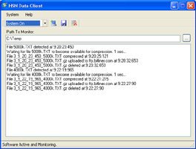
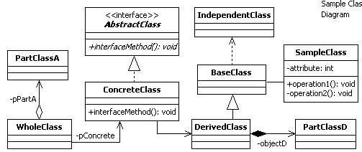
Key Tasks in Architectural Design
Identifying appropriate architectural views
  In complex software systems, there can be numerous stakeholders with different backgrounds.
    These stakeholders have different perception about the system, which influence the way they evaluate the system’s design
  For this reason, architectural designs must support different architectural views used to evaluate the design from a particular stakeholder’s perspective.
  An architectural view is a representation of the system.
    Different representations are required to evaluate certain properties of the system.
View 1
The same system from two different views
View 2
This view is appropriate to evaluate the system’s usability
This view is appropriate to evaluate the system’s reusability
We’ll see more relevant views during session 3

Slide 15
Key Tasks in Architectural Design
Identifying Architectural Styles and Patterns
  The concept of architectural styles and patterns are fundamental to the efficient creation of software architectures.
  They provide an overall strategy for designing a family of software systems.
  They provide reusable architectural solutions, documented in a way that is easily understood and applied.
    For this reason, from the logical perspective, this is one of the first tasks performed during architecture.
  Decisions based on styles and patterns benefit from years of documented experience.
  Today, numerous styles and patterns exist so architects must be aware of these so that they can identify and determine the appropriateness of a particular style or pattern for their system’s design.
Identifying System Interfaces
  Interfaces are defined for components residing within single physical nodes within a single or different process space, or for components residing on different physical nodes.
Identifying Impact of Architectural Decisions in Organization
  Impact on customer base
  Impact on budget and schedule
  Impact on resource availability
Important:
Don’t get stuck on terminology! As you will see later on, Architectural Styles and Architectural Patterns refer to similar concept. During Detailed Design, you will also hear about Design Patterns!

Slide 16
Key Tasks in Architectural Design
Evaluating and Validating the Architecture
  Long and iterative process
  Failure to do so can have significant impact in effort and cost incurred to develop the system.
    It is well known that defects found earlier on in the development process take much less effort to correct than if found at later stages.
  The result should determine if the software architecture is sufficiently complete to support the development of the system.
  We’ll have more to say about this later on in the course…
Introduce Policies for Design Synchronicity
  Design synchronicity is a measurement of the degree of how well the software implementation reflects its design, both in architectural form and detailed design form.
  Obviously, we want high synchronicity, but this is not always the case.
    It is very easy to deviate from design, especially on multi-year efforts.
  For any software architecture effort to result in successful implementation, all subsequent phases and activities must be synchronized with the architecture.
    To do this, a well-defined and understood process must be in place.
    This includes the maintenance phase, which can go on for years after a software has been deployed!

Slide 17
Problem Solving During Architecture
For example, we will reuse our home-grown class framework to leverage our expertise and develop faster!
Other project related constraints
Schedule Constraints,
Cost Constraints,
Quality Constraints
Another example, we will buy and integrate xyz library into our product instead of developing it ourselves
These define the problem and product constraints
Requirements,
System Goals,
Scenarios
Evaluate Constraints
Document
Architectural Designs,
Documentation
Interpret Problem
Collaborative Brainstorming
Evaluate
Architectural Design
Controls Examples:
1. Design reviews must be scheduled with one week of anticipation
2. Software Quality Assurance personnel must be present during review.
3. Review of material containing classified information must occur inside a vault
Unfortunately, these are rarely complete on the first shot!
Resources
Activities
Controls
Development team, modeling software, IDEs, hardware, etc.
Tasks performed to process the requirements
Example: Design Review
These dictate how, when, and where activities are performed!

Slide 18
What’s Next…
In this session, we presented fundamentals concepts of software architecture and key tasks that need to be performed during software architecture, including:
  Identifying stakeholders concerns
  Identify architectural views, styles, and patterns
  Identify major component’s and interfaces
  Evaluating and validating the Architecture
  Introducing policies for design synchronicity
We’ve also mentioned issues with software quality and requirements, but we have not presented the details involved in actually generating good requirements in case that (as architects) we are presented with this problem.
  Next session will focus on requirements engineering, providing enough information to successfully create good requirements.

Slide 19
References
[1] Bass, Len, Paul Clements, and Rick Kazman. Software Architecture in Practice, 2d ed. Boston: Addison-Wesley, 2003.

